Slide 1
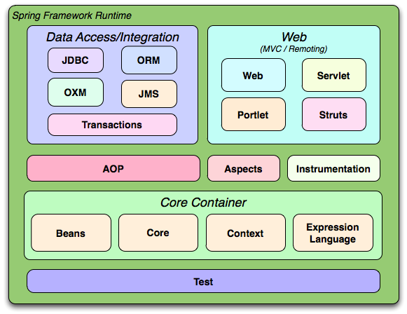
Spring framework
Spring framework: is most popular application development framework of Java.
Main module: Core container, Data access/integration, Web, AOP, Instrumentation, and Test.

Slide 2
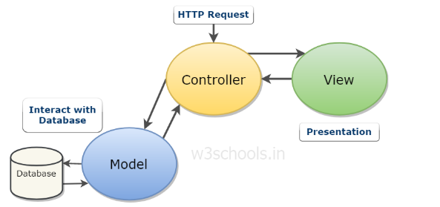
Spring Boot and Spring MVC
Spring boot is a module of Spring framework, allow us to build a stand-alone application with minimal configurations.
Spring MVC is a model view controller-based web framework under the Spring framework.
MVC model: stand for Model-View-Controller.

Slide 3
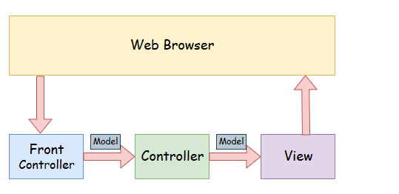
Model: The model encloses the application related data. Model interact with database but doesn’t deal with any logic about how to present the data (business logic).
View: The view element is used to present data of model to the user. This element deals with how to link up with model’s data.
Controller: The controller is in between the model and the view element. It listen to all the incident with data processing based on its model from service layer and actions triggered in the view and performs response back to event.

Slide 4
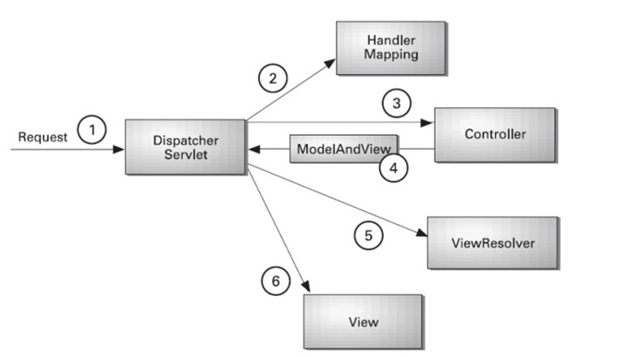
Program flow in MVC model:
1- User send request
2- Dispatcher Servlet (front controller use handler mapping to know what controller deal with this request)
3- Controller receive request, call class services (business layer) to resolve.
4- Controller get model from database and send to dispatcher servlet
5- Dispatcher servlet use view resolver to get response.
6- View template, model, view page are built and send to user

Slide 5
Example about model, view, controller in Spring MVC
Model: Files like Entity, DAO to interact with database
View: Files like JSP, html,…
Controller: Dispatcher Controller, Handler Mapping, Controller delegate requests.
Advantage:
Separate roles: each role can be fulfilled by a specialized object.
Light-weight: It uses light-weight servlet container
Powerful Configuration
Rapid development
Reusable business code
Easy to test
Flexible mapping

Slide 6
Dependency Injection
DI stand for dependency injection, is a pattern we can use to implement IoC. Where the control being inverted is setting an object’s dependency.
Involves 3 types of classes:
Client class: The client class (dependent class) is a class which depends on the service class.
Service class: The service class (dependency class) is a class which provides service the client class.
Injector class: The injector class injects the service class object into the client class.

Slide 7
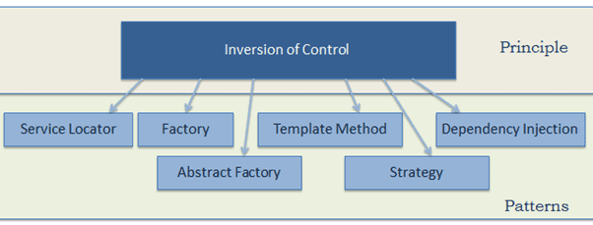
Inversion of Control (IOC)
IoC stand for Inversion of control, traditional way, our code makes call to library. But IoC enables a framework to take control of the flow of program and make call to our code.

Slide 8
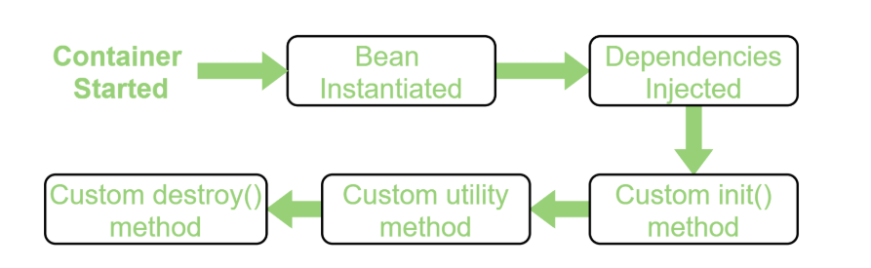
Bean life cycle in Java Spring
Bean life cycle is managed by spring container. When we run the program, the spring container gets started. After that, the container create the instance of a bean then dependency are injected. And finally, the bean is destroyed when the spring container is closed.
Bean basically is an entity in your application.

Slide 9
Spring bean scope
Singleton (default scope)
Prototype
Request
Session Scopes are only available in web application
Application
Web socket

Slide 10
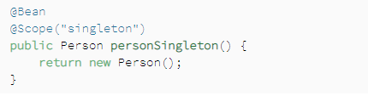
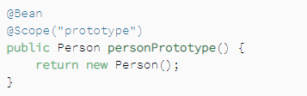
Singleton and prototype scopes
Singleton: the container creates a single instance of that bean; all requests for that bean name will return the same object.
Prototype: will return a different instance every time it is requested from the container.

Slide 11
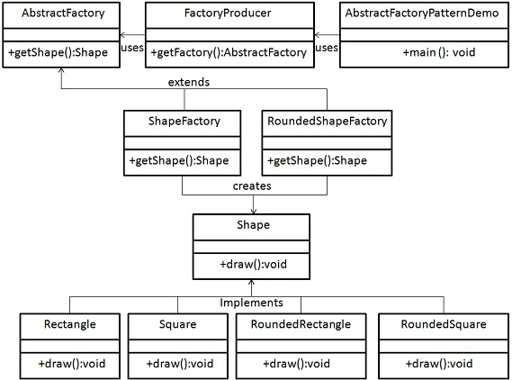
Bean factory and Application context
Both are interface within a spring application that used for providing configuration information to the application
Application context contain all implement of bean factory. Bean factory only load the bean when it is required (lazy loading). Application context will load all the beans instantly (eager loading).
Abstract factory pattern:

Slide 12
3 ways to configure in the Spring Framework
XML-based configuration
Java based configuration
Annotation based configuration

Slide 13
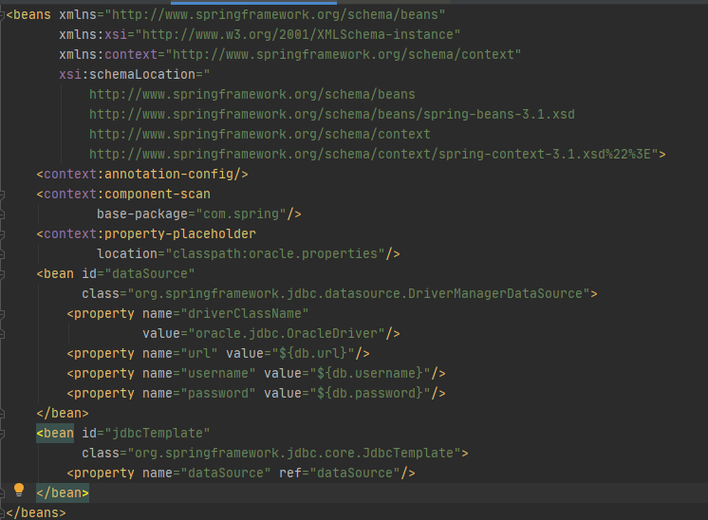
3 ways to configure in the Spring Framework
Annotation based configuration

Slide 14
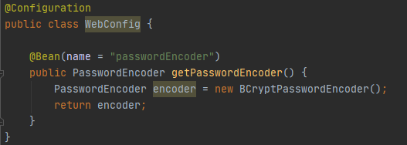
3 ways to configure in the Spring Framework
Java based configuration

Slide 15
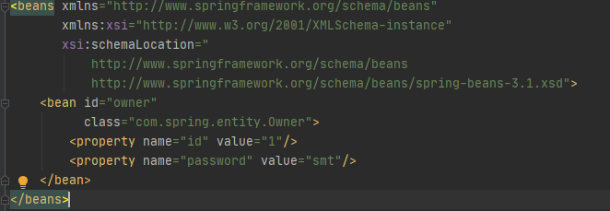
3 ways to configure in the Spring Framework
XML-based configuration

Slide 16
Dependency Injection
Constructor injection: the injector provides service through client class constructor.
Method injection: the client provides service through client class method such as setter or getter.
Property injection: the injector provides through a public property of the client class.

Slide 17
@Autowired: It is used to autowired spring bean on setter method, field and constructor. It allow spring to auto detect and inject bean which we have already declared in class.
@Autowired on Properties: when the annotation is directly used on properties. Spring looks for and injects bean when object is created. This is how to eliminates the need for getters and setters.
@Autowired on Setter: when the annotation is used on the setter method, the setter method is called with the instance of bean when object is created.
@Autowired on Constructor: when the annotation is used on constructor, an instance of bean is injected as an argument to the constructor when object is created.

Slide 18
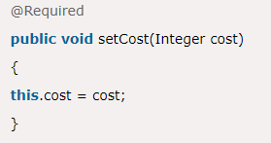


Some Annotation in Spring
@Required: It applies to the bean setter method. It indicates that the annotated bean must be populated at configuration time with the required property
@Qualifier: show how to differentiate beans of the same type. Uniquely identifies this bean with its string
@Component: It is a class-level annotation. It is used to mark a Java class as a bean. The spring framework pick it up and configure it in the application context as a Spring bean

Slide 19
@Controller, @Service and @Repository
@Controller: is class-level annotation. It marks a class as a web request handler. It is mostly used with @RequestMapping annotation
@Service: is also used at class level, It tell the Spring that class contain business logic.
@Repository: the repository is a DAOs (Data Access Objects) that access the database directly. The repository does all the operations related to the database.

Slide 20
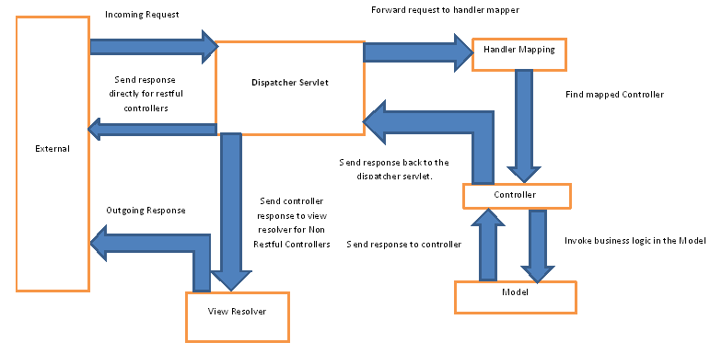
Front-controller and flow of a request.
Front controller is DispatcherServlet class.

Slide 21
View resolver
Is which enable to render model in the browser without typing the implementation to a specific view technology.
Spring framework come with quite a few resolver like: InternalResourceViewResolver, XmlViewResolver, ResourceBundleViewResolver

Slide 22
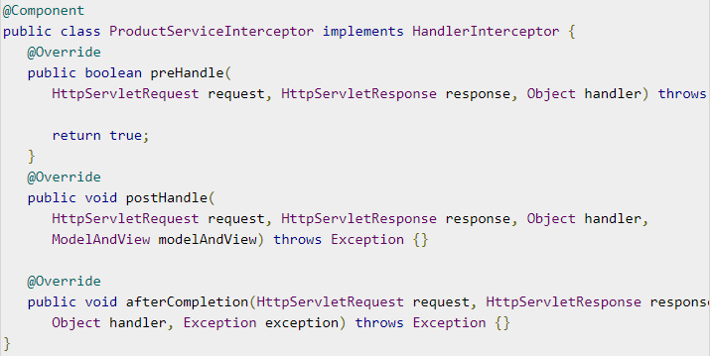
Interceptor
To perform operations under the following situations
Before sending request to the controller (preHandle)
Before sending the response to the client (postHandle)
afterCompletion(): used to perform operations after completing the request and response

Slide 23
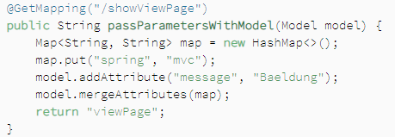
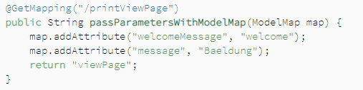
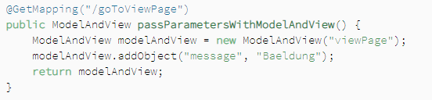
Model, ModelMap, ModelAndView
Model: the model can supply attributes used for rendering views, we add this data to object.
ModelMap: just like Model, but ModelMap allows us to parse a collection of values and treat them like Model.
ModelAndView: allow us to parse all information required by Spring MVC

Slide 24
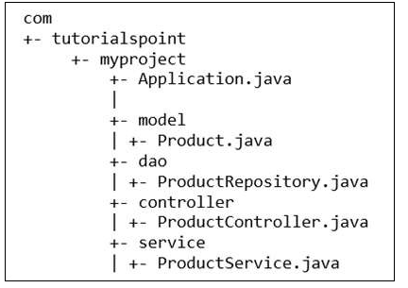
Typical layout Example of the typical layout of Spring Boot Application:

Slide 25
Spring MVC and REST Annotation
@RequestMapping: It is used to map the web request. It has many optional elements like: consumes, header, method, name, params, path, procedures.
@GetMapping: It map the HTTP GET method on the specific handler method. It used to create a web service endpoint that fetches. Instead of using: @RequestMapping(method = RequestMapping.GET)
@PostMapping: equals HTTP POST, endpoint that creates. (method = RequestMapping.POST)
@PutMapping: equals HTTP PUT, endpoint that creates or updates. (method = RequestMapping.PUT)
@DeleteMapping: equals HTTP DELETE, endpoint that delete a resource. (method = RequestMapping.DELETE)
@PatchMapping: equals HTTP PATCH, endpoint that creates. (method = RequestMapping.POST)

Slide 26
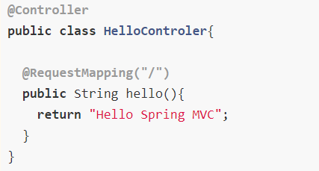
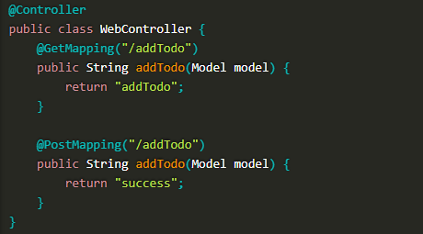
Example REST Annotation Different kinds of annotation:

Slide 27
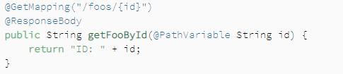

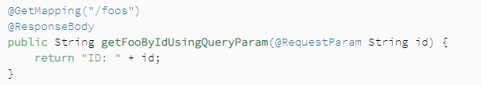

@RequestParam and @PathVariable
@RequestParam extracts values from the query string. @PathVariable extracts value from the URL path. Most suitable for the RESTFul Web Service.
And for RequestParam: known as query parameter. It can specify default values if the query parameters are not present in the URL.

Slide 28
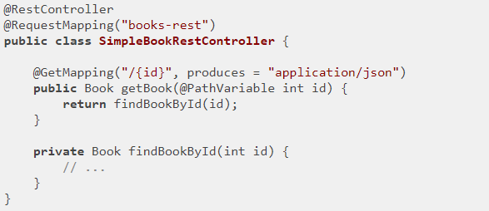
@RestController
Is combination of @Controller and @ResponseBody annotation. The @RestController annotation is itself annotated with the @ResponseBody annotation. It eliminates the need for annotating each method with @ResponseBody. This annotation allow you to auto return object into HttpResponse.

